Slide 1




Basics of Image Registration
MICCAI Educational Challenge 2018
Iman Aganj
Athinoula A. Martinos Center for Biomedical Imaging
Massachusetts General Hospital, Harvard Medical School
Computer Science and Artificial Intelligence Laboratory
Massachusetts Institute of Technology

Slide 2


Image Registration
Spatial Correspondence
Photo by:
Manu H., pentaxforums.com
Photo by:
David L. Ryan, Boston Globe

Slide 3
Application:
Intrasubject Image Registration
Multiple Contrasts
T1
T2
PD
PET
CT
Brain images from the RIRE dataset (Fitzpatrick et al, IEEE Trans Med Imag, 1998)

Slide 4
Application:
Intrasubject Image Registration
Longitudinal Images
Baseline
3 months
6 months
1 year
2 years
Brain images from the ADNI dataset (adni.loni.usc.edu)

Slide 5
Application:
Inter-subject Image Registration
Group Analysis & Comparison
Group 1
Subject 1
Subject 2
Subject 3
Subject 4
Group 2
Subject 1
Subject 2
Subject 3
Subject 4
Brain images from the OASIS database (Marcus et al, J Cogn Neurosci, 2007)

Slide 6
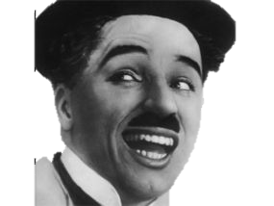
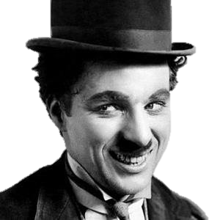
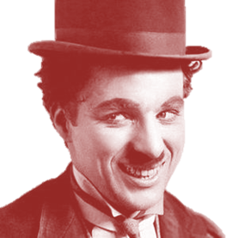
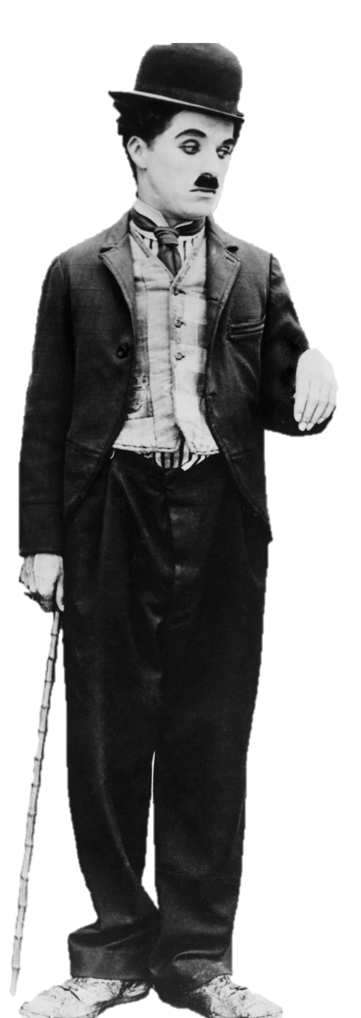
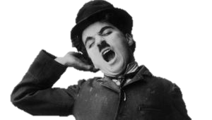
Image Registration
Linear Alignment

Slide 7
Image Registration
Deformable Alignment
before
after
after registered to before
Notes:
Image registration is useful in population and longitudinal studies. Non-rigid pairwise image registration provides a dense point-wise correspondence between the two input images.

Slide 8
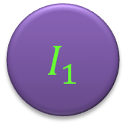
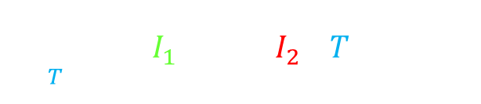
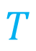
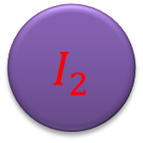
Image Registration Objective Function
Same-Contrast Images
$$I_{1}$$
$$I_{2}$$
$$T$$
Sum-of-squared-differences data term:
$$\underset{T}{argmin}{\int{{\left(I_{1}\left(x\right)−\left(I_{2}∘T\right)\left(x\right)\right)}^{2}dx}}$$
$I_{1},I_{2}$: Images
$T$: Transformation
Notes:
A change of variables and further calculation reveal that the data term is, remarkably, only a function of $T$, the transformation that takes one image to the other. So, we can minimize this data term directly with respect to $T$, as opposed to the previous methods that optimize their cost functions with respect to both $T_{1}$ and $T_{2}$, conditioned to constraints that prevent the mid-space drift. With this data term being independent of $T_{1}$ and $T_{2}$, the mid-space disappears, also eliminating the problem of the mid-space drift. We don’t need to enforce any anti-drift constraints anymore, and we won’t bias the space of possible transformations by the particular choice of such constraints. This is all while keeping the degrees of freedom of the optimization half of that of the unconstrained problem of solving for both $T_{1}$ and $T_{2}$. In addition, one can verify the symmetry of this data term, which, however, holds only in the continuous domain. In the discrete case, where one image is resampled and the other is not, discretization artifacts may produce a bias.

Slide 9
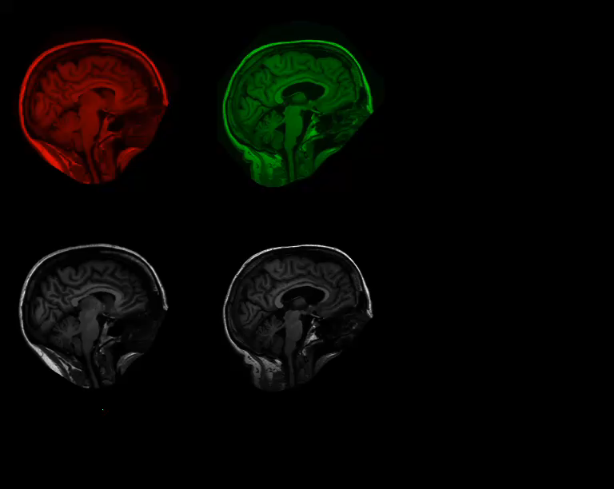


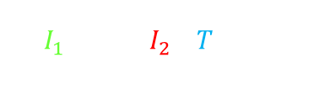
Image Registration Objective Function
Same-Contrast Images
$I_{1} ,$ $I_{2}∘T$
$${\left(I_{1}−I_{2}∘T\right)}^{2}$$
$$\int{{\left(I_{1}\left(x\right)−\left(I_{2}∘T\right)\left(x\right)\right)}^{2}dx}$$
Notes:
A change of variables and further calculation reveal that the data term is, remarkably, only a function of $T$, the transformation that takes one image to the other. So, we can minimize this data term directly with respect to $T$, as opposed to the previous methods that optimize their cost functions with respect to both $T_{1}$ and $T_{2}$, conditioned to constraints that prevent the mid-space drift. With this data term being independent of $T_{1}$ and $T_{2}$, the mid-space disappears, also eliminating the problem of the mid-space drift. We don’t need to enforce any anti-drift constraints anymore, and we won’t bias the space of possible transformations by the particular choice of such constraints. This is all while keeping the degrees of freedom of the optimization half of that of the unconstrained problem of solving for both $T_{1}$ and $T_{2}$. In addition, one can verify the symmetry of this data term, which, however, holds only in the continuous domain. In the discrete case, where one image is resampled and the other is not, discretization artifacts may produce a bias.

Slide 10
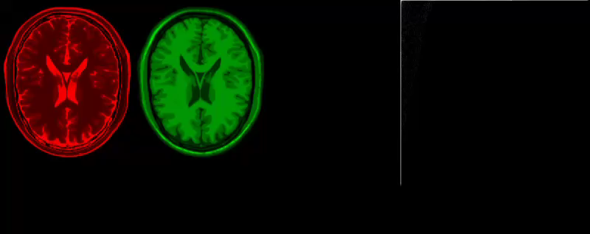
Image Registration Objective Function
Multi-Contrast Images
$I_{1} ,$ $I_{2}∘T$
Joint Entropy
(Mutual Information, Normalized Mutual Information, etc.)
Joint Histogram
(Wells et al, MedIA’96; Maes et al, TMI’97; Studholme et al, SPIE’98)
Brain images from the BrainWeb database (Collins et al, IEEE Trans Med Imag, 1998)
Notes:
A change of variables and further calculation reveal that the data term is, remarkably, only a function of $T$, the transformation that takes one image to the other. So, we can minimize this data term directly with respect to $T$, as opposed to the previous methods that optimize their cost functions with respect to both $T_{1}$ and $T_{2}$, conditioned to constraints that prevent the mid-space drift. With this data term being independent of $T_{1}$ and $T_{2}$, the mid-space disappears, also eliminating the problem of the mid-space drift. We don’t need to enforce any anti-drift constraints anymore, and we won’t bias the space of possible transformations by the particular choice of such constraints. This is all while keeping the degrees of freedom of the optimization half of that of the unconstrained problem of solving for both $T_{1}$ and $T_{2}$. In addition, one can verify the symmetry of this data term, which, however, holds only in the continuous domain. In the discrete case, where one image is resampled and the other is not, discretization artifacts may produce a bias.

Slide 11
Interpolation & Resampling
Notes:
A change of variables and further calculation reveal that the data term is, remarkably, only a function of $T$, the transformation that takes one image to the other. So, we can minimize this data term directly with respect to $T$, as opposed to the previous methods that optimize their cost functions with respect to both $T_{1}$ and $T_{2}$, conditioned to constraints that prevent the mid-space drift. With this data term being independent of $T_{1}$ and $T_{2}$, the mid-space disappears, also eliminating the problem of the mid-space drift. We don’t need to enforce any anti-drift constraints anymore, and we won’t bias the space of possible transformations by the particular choice of such constraints. This is all while keeping the degrees of freedom of the optimization half of that of the unconstrained problem of solving for both $T_{1}$ and $T_{2}$. In addition, one can verify the symmetry of this data term, which, however, holds only in the continuous domain. In the discrete case, where one image is resampled and the other is not, discretization artifacts may produce a bias.

Slide 12
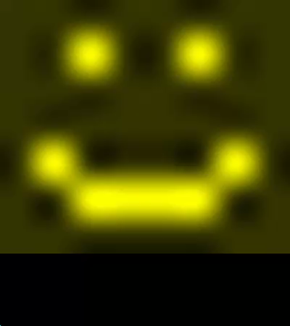
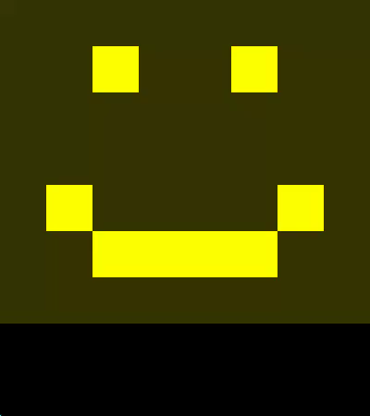
Resampling (Causing Asymmetry)
Interpolation Artifacts
Resampling Artifacts
(Pluim et al, CVIU 2000; Tsao, TMI’03; Rohde et al, TIP’09; Aganj et al, TIP’13)
Notes:
A change of variables and further calculation reveal that the data term is, remarkably, only a function of $T$, the transformation that takes one image to the other. So, we can minimize this data term directly with respect to $T$, as opposed to the previous methods that optimize their cost functions with respect to both $T_{1}$ and $T_{2}$, conditioned to constraints that prevent the mid-space drift. With this data term being independent of $T_{1}$ and $T_{2}$, the mid-space disappears, also eliminating the problem of the mid-space drift. We don’t need to enforce any anti-drift constraints anymore, and we won’t bias the space of possible transformations by the particular choice of such constraints. This is all while keeping the degrees of freedom of the optimization half of that of the unconstrained problem of solving for both $T_{1}$ and $T_{2}$. In addition, one can verify the symmetry of this data term, which, however, holds only in the continuous domain. In the discrete case, where one image is resampled and the other is not, discretization artifacts may produce a bias.

Slide 13
Volume Change in Deformable Registration
$$I_{1}$$
$$I_{2}$$
$$I_{2}∘T$$
Notes:
In pairwise deformable image registration, we often minimize a cost function while deforming one image or both of them. The choice of the reference image affects the registration, thereby breaking the registration symmetry.

Slide 14
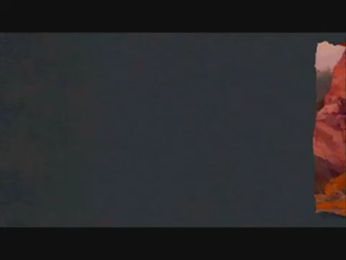
Notes:
In pairwise deformable image registration, we often minimize a cost function while deforming one image or both of them. The choice of the reference image affects the registration, thereby breaking the registration symmetry.

Slide 15
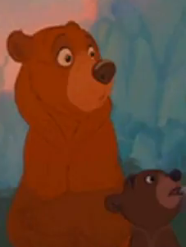
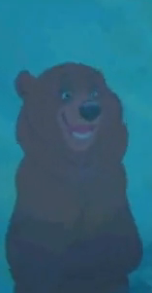
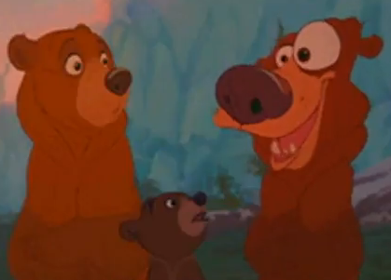
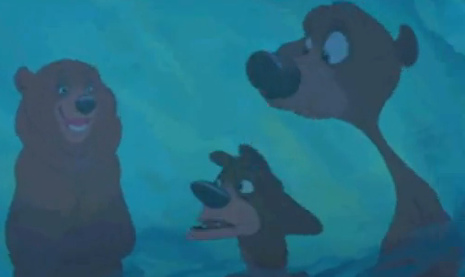




Asymmetry in Deformable Registration
$$I_{1}$$
$$I_{2}$$
$$I_{1}$$
$$I_{2}∘T$$
$$I_{1}∘T^{−1}$$
$$I_{2}$$
$$\int{{\left(I_{1}\left(x\right)−\left(I_{2}∘T\right)\left(x\right)\right)}^{2}dx} ≠ \int{{\left(\left(I_{1}∘T^{−1}\right)\left(x\right)−I_{2}\left(x\right)\right)}^{2}dx}$$
$$\underset{T}{argmin}{\int{{\left(I_{1}\left(x\right)−\left(I_{2}∘T\right)\left(x\right)\right)}^{2}dx}} ≠ \underset{T}{argmin}{\int{{\left(\left(I_{1}∘T^{−1}\right)\left(x\right)−I_{2}\left(x\right)\right)}^{2}dx} }$$
Brother Bear, © Disney
Notes:
In pairwise deformable image registration, we often minimize a cost function while deforming one image or both of them. The choice of the reference image affects the registration, thereby breaking the registration symmetry.

Slide 16
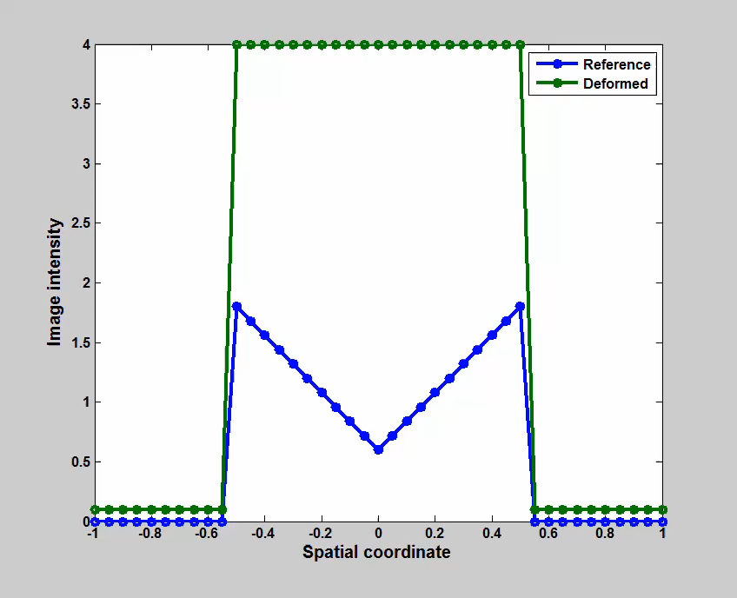
Asymmetry due to Non-uniformity
Notes:
In this 1D example, the blue (reference) and green (deformed) images are registered with each other. Since the foreground of the blue image matches better with the background of the green image as opposed to its foreground, the green image is shrunk to a point. Regularization would oppose this, but the shrinkage would still happen to some extent.

Slide 17
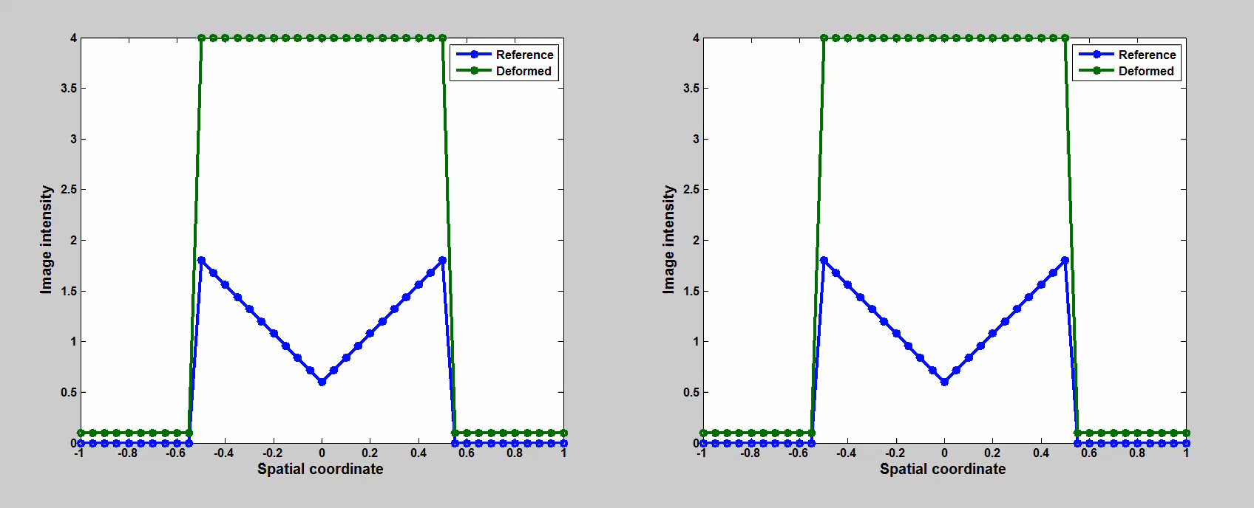
Asymmetry due to Non-uniformity
Reference image space
Deformed image space
Notes:
Here we see the same video (left), in addition to the same transformation as viewed by the deformed (green) image (right). I.e., on the right, the inverse of the transformation is applied on the blue image…

Slide 18
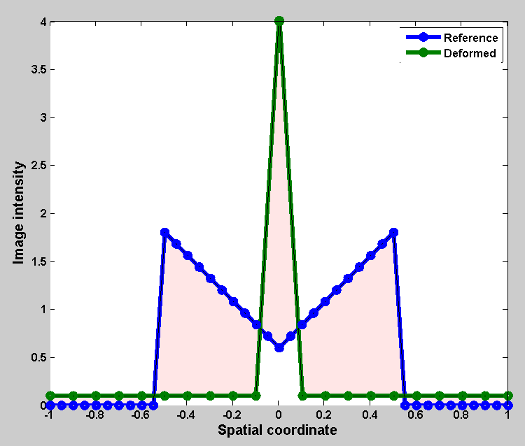
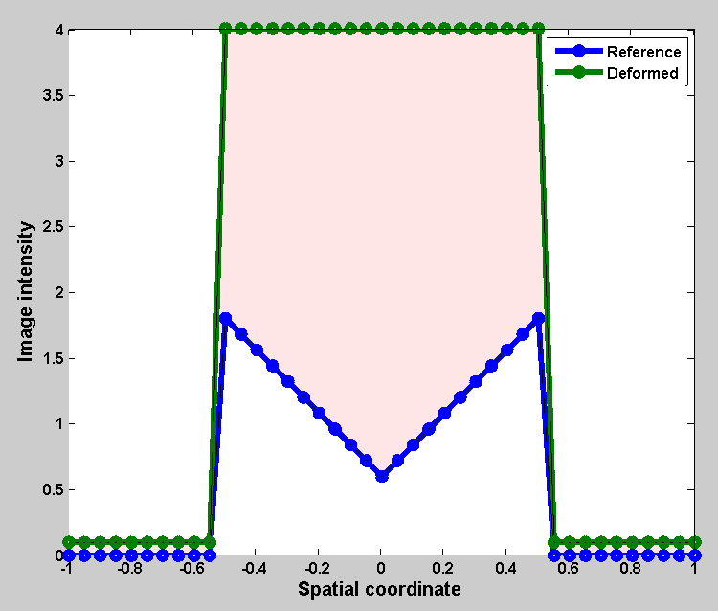
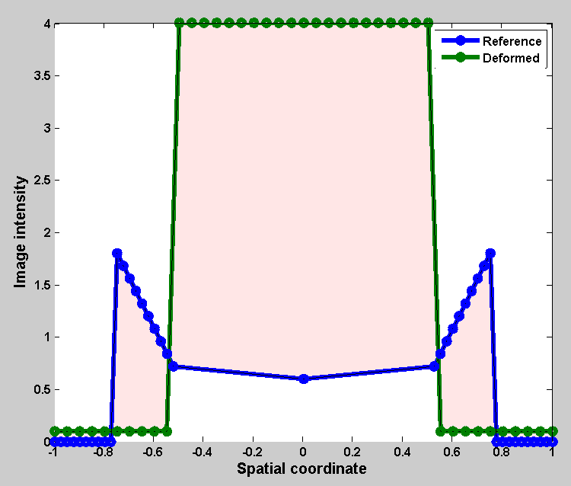
Asymmetry due to Non-uniformity
After: Reference image space
Before registration
After: Deformed image space
(Aganj et al, NeuroImage, 2015)
Notes:
As we see here, the aggregate image dissimilarity (shared area) has decreased from the perspective of the reference image, but increased from that of the deformed image. So the observer in the native space of the green image (that is as important as the blue image) is not happy with the registration results.

Slide 19
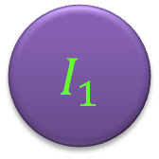
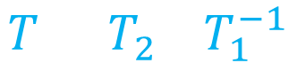
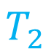
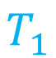
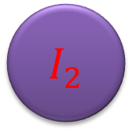
Mid-Space Approach to Symmetry
Mid-Space
$$T_{1}$$
$$T_{2}$$
$$I_{1}$$
$$I_{2}$$
$$T=T_{2}∘T_{1}^{−1}$$
$I_{1},I_{2}$: Images
$T_{1},T_{2}$: Transformations
(Lorenzen et al, MedIA’06; Avants et al, NI’04; Yang et al, PMB’08)
Notes:
In a common approach to achieve symmetry, both images are deformed and compared in a mid-space, which makes the registration invariant with respect to the ordering of the images. Such methods essentially minimize their cost functions with respect to two transformations $T_{1}$ and $T_{2}$ that take the two input images to the mid-space. Without additional constraints, however, this increases the degrees of freedom of the problem twofold, since the end result of pairwise registration is really one transformation, $T$, that takes the second input image to the first. In addition, the mid-space can drift arbitrarily far away from the native spaces of the images. To alleviate these issues, some additional anti-drift constraints are used to keep the mid-space “in between” the native spaces of the two images. For example, they may restrict $T_{1}$ and $T_{2}$ to have opposite displacement fields, or to be the inverse of each other. The choice of the anti-drift constraints may bias the registration algorithm towards favoring a particular set of transformations, and therefore affect the results.

Slide 20
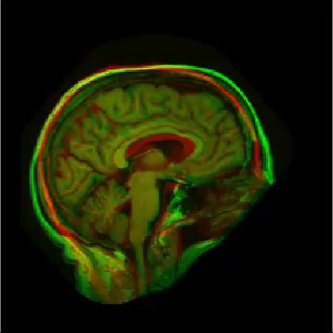

Without Regularization
$$I_{1}$$
$$I_{2}$$
$$I_{2}∘T$$
$$\underset{T}{argmin}{\int{{\left(I_{1}\left(x\right)−\left(I_{2}∘T\right)\left(x\right)\right)}^{2}dx}}$$
$T$: Transformation by sorting and matching pixel intensities
Example proposed by Rohlﬁng et al (IEEE Trans Med Imag, 2012)
Notes:
In a common approach to achieve symmetry, both images are deformed and compared in a mid-space, which makes the registration invariant with respect to the ordering of the images. Such methods essentially minimize their cost functions with respect to two transformations $T_{1}$ and $T_{2}$ that take the two input images to the mid-space. Without additional constraints, however, this increases the degrees of freedom of the problem twofold, since the end result of pairwise registration is really one transformation, $T$, that takes the second input image to the first. In addition, the mid-space can drift arbitrarily far away from the native spaces of the images. To alleviate these issues, some additional anti-drift constraints are used to keep the mid-space “in between” the native spaces of the two images. For example, they may restrict $T_{1}$ and $T_{2}$ to have opposite displacement fields, or to be the inverse of each other. The choice of the anti-drift constraints may bias the registration algorithm towards favoring a particular set of transformations, and therefore affect the results.

Slide 21
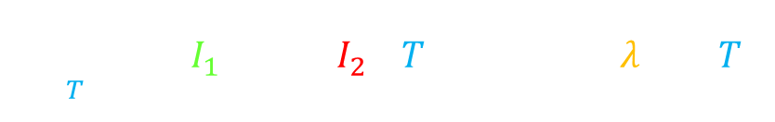

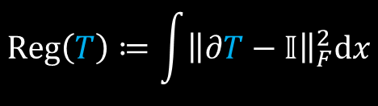
Regularization
$$\underset{T}{argmin}{\int{{\left(I_{1}\left(x\right)−\left(I_{2}∘T\right)\left(x\right)\right)}^{2}dx}+λReg\left(T\right)}$$
$$Reg\left(T\right)≔\int{{\left\|∂T−𝕀\right\|}_{F}^{2}dx}$$
$$\det{∂T}>0$$
(Diffeomorphism)
(Vercauteren et al, NeuroImage, 2009)
Notes:
In a common approach to achieve symmetry, both images are deformed and compared in a mid-space, which makes the registration invariant with respect to the ordering of the images. Such methods essentially minimize their cost functions with respect to two transformations $T_{1}$ and $T_{2}$ that take the two input images to the mid-space. Without additional constraints, however, this increases the degrees of freedom of the problem twofold, since the end result of pairwise registration is really one transformation, $T$, that takes the second input image to the first. In addition, the mid-space can drift arbitrarily far away from the native spaces of the images. To alleviate these issues, some additional anti-drift constraints are used to keep the mid-space “in between” the native spaces of the two images. For example, they may restrict $T_{1}$ and $T_{2}$ to have opposite displacement fields, or to be the inverse of each other. The choice of the anti-drift constraints may bias the registration algorithm towards favoring a particular set of transformations, and therefore affect the results.

Slide 22
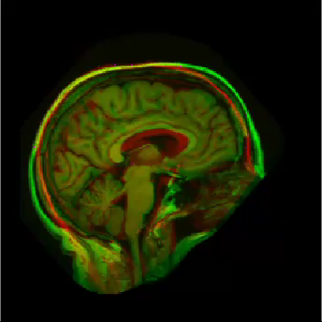
Regularization
Notes:
In a common approach to achieve symmetry, both images are deformed and compared in a mid-space, which makes the registration invariant with respect to the ordering of the images. Such methods essentially minimize their cost functions with respect to two transformations $T_{1}$ and $T_{2}$ that take the two input images to the mid-space. Without additional constraints, however, this increases the degrees of freedom of the problem twofold, since the end result of pairwise registration is really one transformation, $T$, that takes the second input image to the first. In addition, the mid-space can drift arbitrarily far away from the native spaces of the images. To alleviate these issues, some additional anti-drift constraints are used to keep the mid-space “in between” the native spaces of the two images. For example, they may restrict $T_{1}$ and $T_{2}$ to have opposite displacement fields, or to be the inverse of each other. The choice of the anti-drift constraints may bias the registration algorithm towards favoring a particular set of transformations, and therefore affect the results.

Slide 23
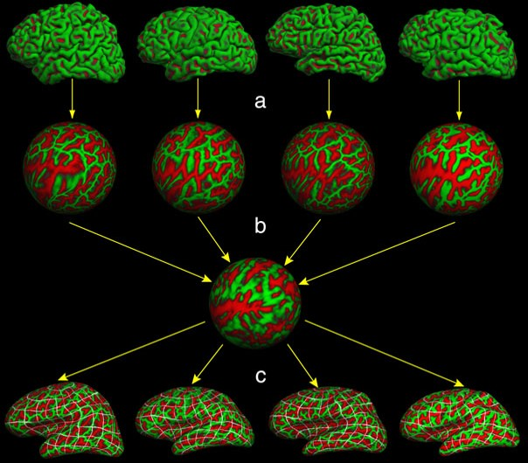
Surface-Based Registration
Template/Atlas construction →
FreeSurfer (Fischl et al, NeuroImage, 1999; Hum Brain Mapp, 1999) – Figure from Doug Greve
Notes:
In a common approach to achieve symmetry, both images are deformed and compared in a mid-space, which makes the registration invariant with respect to the ordering of the images. Such methods essentially minimize their cost functions with respect to two transformations $T_{1}$ and $T_{2}$ that take the two input images to the mid-space. Without additional constraints, however, this increases the degrees of freedom of the problem twofold, since the end result of pairwise registration is really one transformation, $T$, that takes the second input image to the first. In addition, the mid-space can drift arbitrarily far away from the native spaces of the images. To alleviate these issues, some additional anti-drift constraints are used to keep the mid-space “in between” the native spaces of the two images. For example, they may restrict $T_{1}$ and $T_{2}$ to have opposite displacement fields, or to be the inverse of each other. The choice of the anti-drift constraints may bias the registration algorithm towards favoring a particular set of transformations, and therefore affect the results.

Slide 24


Image-Atlas Registration
Label Propagation
$$T$$
$$I$$
$$I≈A∘T$$
$$A$$
$$T$$
$$L∘T$$
$$L$$
Notes:
In a common approach to achieve symmetry, both images are deformed and compared in a mid-space, which makes the registration invariant with respect to the ordering of the images. Such methods essentially minimize their cost functions with respect to two transformations $T_{1}$ and $T_{2}$ that take the two input images to the mid-space. Without additional constraints, however, this increases the degrees of freedom of the problem twofold, since the end result of pairwise registration is really one transformation, $T$, that takes the second input image to the first. In addition, the mid-space can drift arbitrarily far away from the native spaces of the images. To alleviate these issues, some additional anti-drift constraints are used to keep the mid-space “in between” the native spaces of the two images. For example, they may restrict $T_{1}$ and $T_{2}$ to have opposite displacement fields, or to be the inverse of each other. The choice of the anti-drift constraints may bias the registration algorithm towards favoring a particular set of transformations, and therefore affect the results.

Slide 25
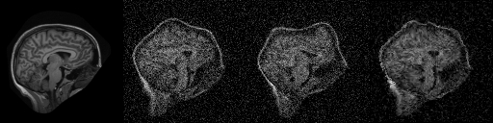





Validation of Registration
Synthetic Transformations
Notes:
In a common approach to achieve symmetry, both images are deformed and compared in a mid-space, which makes the registration invariant with respect to the ordering of the images. Such methods essentially minimize their cost functions with respect to two transformations $T_{1}$ and $T_{2}$ that take the two input images to the mid-space. Without additional constraints, however, this increases the degrees of freedom of the problem twofold, since the end result of pairwise registration is really one transformation, $T$, that takes the second input image to the first. In addition, the mid-space can drift arbitrarily far away from the native spaces of the images. To alleviate these issues, some additional anti-drift constraints are used to keep the mid-space “in between” the native spaces of the two images. For example, they may restrict $T_{1}$ and $T_{2}$ to have opposite displacement fields, or to be the inverse of each other. The choice of the anti-drift constraints may bias the registration algorithm towards favoring a particular set of transformations, and therefore affect the results.

Slide 26
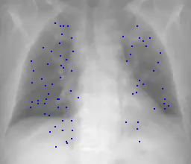
Validation of Registration
Manual Landmarks
CT images from DIR-LAB (Castillo et al, Phys Med Biol, 2009)
Notes:
In a common approach to achieve symmetry, both images are deformed and compared in a mid-space, which makes the registration invariant with respect to the ordering of the images. Such methods essentially minimize their cost functions with respect to two transformations $T_{1}$ and $T_{2}$ that take the two input images to the mid-space. Without additional constraints, however, this increases the degrees of freedom of the problem twofold, since the end result of pairwise registration is really one transformation, $T$, that takes the second input image to the first. In addition, the mid-space can drift arbitrarily far away from the native spaces of the images. To alleviate these issues, some additional anti-drift constraints are used to keep the mid-space “in between” the native spaces of the two images. For example, they may restrict $T_{1}$ and $T_{2}$ to have opposite displacement fields, or to be the inverse of each other. The choice of the anti-drift constraints may bias the registration algorithm towards favoring a particular set of transformations, and therefore affect the results.

Slide 27
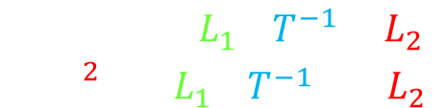
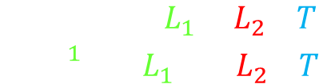


Validation of Registration
Manual Labels
$${Dice}_{1}≔\frac{2\left|L_{1}∩L_{2}∘T\right|}{\left|L_{1}\right|+\left|L_{2}∘T\right|}$$
$$L_{1}$$
$$L_{2}∘T$$
$${Dice}_{2}≔\frac{2\left|L_{1}∘T^{−1}∩L_{2}\right|}{\left|L_{1}∘T^{−1}\right|+\left|L_{2}\right|}$$
Label images of the “Buckner 40” dataset (Fischl et al, Neuron, 2002)
Notes:
In a common approach to achieve symmetry, both images are deformed and compared in a mid-space, which makes the registration invariant with respect to the ordering of the images. Such methods essentially minimize their cost functions with respect to two transformations $T_{1}$ and $T_{2}$ that take the two input images to the mid-space. Without additional constraints, however, this increases the degrees of freedom of the problem twofold, since the end result of pairwise registration is really one transformation, $T$, that takes the second input image to the first. In addition, the mid-space can drift arbitrarily far away from the native spaces of the images. To alleviate these issues, some additional anti-drift constraints are used to keep the mid-space “in between” the native spaces of the two images. For example, they may restrict $T_{1}$ and $T_{2}$ to have opposite displacement fields, or to be the inverse of each other. The choice of the anti-drift constraints may bias the registration algorithm towards favoring a particular set of transformations, and therefore affect the results.

Slide 28
Thank You!

